Slide 1
Lecture 4:
What Is a UI ?
A user interface (UI) is a graphical display in one or more windows containing controls, called components, that enable a user to perform interactive tasks. The user does not have to create a script or type commands at the command line to accomplish the tasks. Unlike coding programs to accomplish tasks, the user does not need to understand the details of how the tasks are performed. ®
UI components can include menus, toolbars, push buttons, radio buttons, list boxes, and sliders—just to name a few. UIs created using MATLAB® tools can also perform any type of computation, read and write data files, communicate with other UIs, and display data as tables or as plots. The following figure illustrates a simple UI that you can easily build yourself Creating

Slide 2
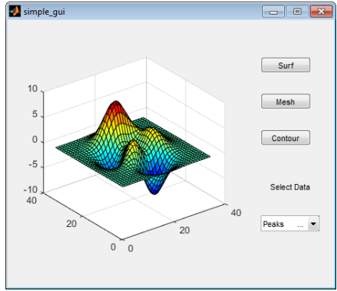
.Graphical User Interfaces

Slide 3
The UI contains these components: • An axes component • A pop-up menu listing three data sets that correspond to MATLAB functions: peaks, membrane, and sinc
• A static text component to label the pop-up menu • Three buttons that provide different kinds of plots: surface, mesh, and contour When you click a push button, the axes component displays the selected data set using the specified type of 3-D plot.
How Does a UI Work?
Typically, UIs wait for a user to manipulate a control, and then respond to each user action in turn. Each control, and the UI itself, has one or more callbacks, named for the fact that they “call back” to MATLAB to ask it to do things. A particular user action,such as pressing a screen button, or passing the cursor over a component, triggers the execution of each callback. The UI then responds to these events. You, as the UI creator, write callbacks that define what the components do to handle events. This kind of programming is often referred to as event-driven programming. In eventdriven programming, callback execution is asynchronous, that is, events external to the software trigger callback execution. In the case of MATLAB UIs, most events are user interactions with the UI, but the UI can respond to other kinds of events as well, for example, the creation of a file or connecting a device to the computer.

Slide 4
Using functions stored in code files as callbacks is preferable to using strings, because functions have access to arguments and are more powerful and flexible. You cannot use MATLAB scripts (sequences of statements stored in code files that do not define functions) as callbacks. Although you can provide a callback with certain data and make it do anything you want, you cannot control when callbacks execute. That is, when your UI is being used, you have no control over the sequence of events that trigger particular callbacks or what other callbacks might still be running at those times. This distinguishes event-driven programming from other types of control flow, for example, processing sequential data files.

Slide 5
Ways to Build MATLAB UIs A MATLAB UI is a figure window to which you add user-operated components. You can select, size, and position these components as you like. Using callbacks you can make the components do what you want when the user clicks or manipulates the components with keystrokes. You can build MATLAB UIs in two ways: • Create the UI using GUIDE This approach starts with a figure that you populate with components from within a graphic layout editor. GUIDE creates an associated code file containing callbacks for the UI and its components. GUIDE saves both the figure (as a FIG-file) and the code file. You can launch your application from either file. • Create the UI programmatically Using this approach, you create a code file that defines all component properties and behaviors. When a user executes the file, it creates a figure, populates it with components, and handles user interactions. Typically, the figure is not saved between sessions because the code in the file creates a new one each time it runs. The code files of the two approaches look different.

Slide 6
Programmatic UI files are generally longer, because they explicitly define every property of the figure and its controls, as well as the callbacks. GUIDE UIs define most of the properties within the figure itself. They store the definitions in its FIG-file rather than in its code file. The code file contains callbacks and other functions that initialize the UI when it opens. You can create a UI with GUIDE and then modify it programmatically. However, you cannot create a UI programmatically and then modify it with GUIDE. The approach you choose depends on your experience, your preferences, and your goals. Here are some ways to achieve specific goals.

Slide 7
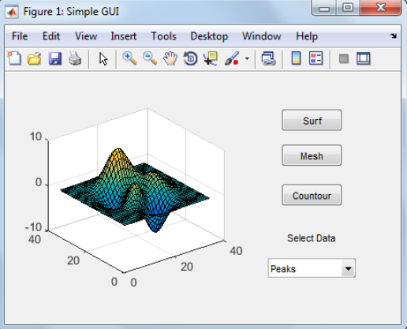
Create a Simple UI Programmatically
This example shows how to create a simple UI programmatically, such as the one shown here.

Slide 8
Create a Code File for the Simple Programmatic UI Create a function file (as opposed to a script file, which contains a sequence of MATLAB commands but does not define functions). 1. At the MATLAB prompt, type edit. 2. Type the following statement in the first line of the Editor. function simple_gui2 3. Following the function statement, type these comments, ending with a blank line. (The comments display at the command line in response to the help command.) % SIMPLE_GUI2 Select a data set from the pop-up menu, then % click one of the plot-type push buttons. Clicking the button % plots the selected data in the axes. (Leave a blank line here) 4. At the end of the file, after the blank line, add an end statement.
Note: - You need the end statement to specify the end of the function because the example uses nested functions. To learn more, see “Nested Functions”. 5. Save the file in your current folder or at a location that is on your MATLAB path.

